Slide 1

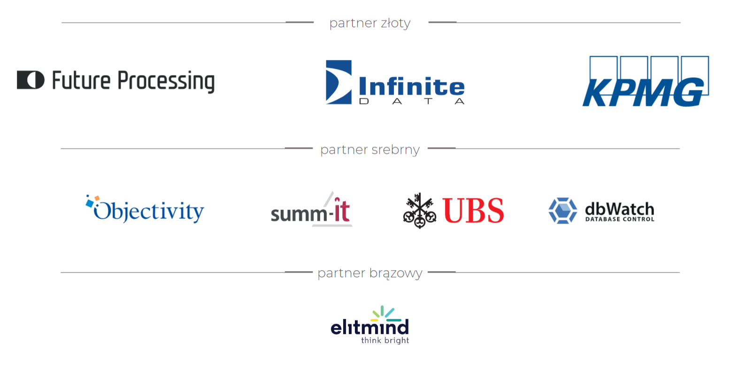

Slide 2

Artificial Intelligence in medicine, or how to properly run an ML project

Slide 3




Ada Pałka-Muskietorz

Slide 4











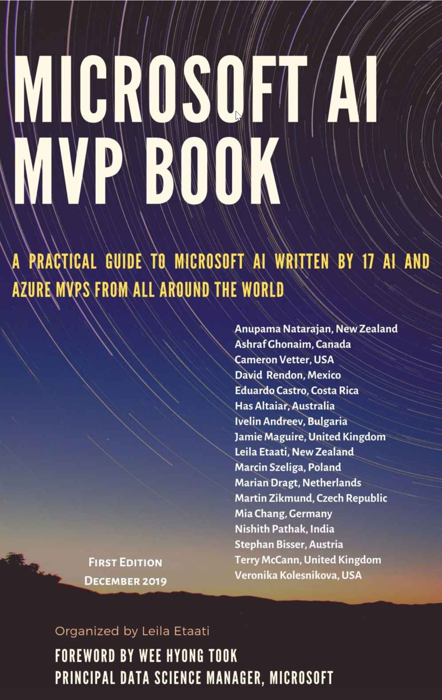

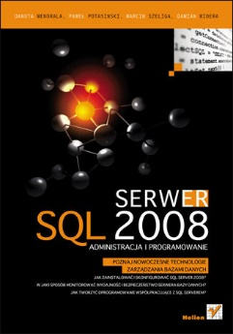


Marcin Szeliga

Slide 5
AGENDA
Data Science Lifecycle
Environment
Transfer Learning
Automated Machine Learning

Slide 6

Data Science Lifecycle
source https://docs.microsoft.com/en-us/azure/architecture/data-science-process/overview

Slide 7

Environment
Azure Machine Learning Service
Set of Azure Cloud Services
Python & R SDK
That enables you to:
Prepare Data
Build Models
Train Models
Manage Models
Track Experiments
Deploy Models

Slide 8
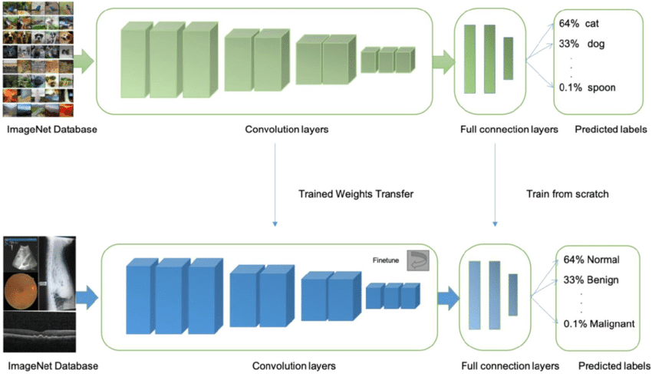
Transfer Learning
source https://dev.to/amananandrai/pretrained-models-for-transfer-learning-in-keras-for-computer-vision-5eei

Slide 9
Automated Machine Learning
Which features?
Which algorithm?
Which hyperparameters?
Mileage
Condition
Car brand
Year of make
Regulations
…
Gradient Boosted
Nearest Neighbors
SVM
Bayesian Regression
LGBM
…
Parameter 1
Parameter 2
Parameter 3
Parameter 4
…
Mileage
Gradient Boosted
Criterion
Loss
Min Samples Split
Min Samples Leaf
Others
Car brand
Year of make
30%
Model

Slide 10
Automated Machine Learning
Which features?
Which algorithm?
Which hyperparameters?
Mileage
Condition
Car brand
Year of make
Regulations
…
Gradient Boosted
Nearest Neighbors
SVM
Bayesian Regression
LGBM
…
Criterion
Loss
Min Samples Split
Min Samples Leaf
Others
Mileage
Gradient Boosted
N Neighbors
Weights
Metric
P
Others
Condition
Nearest Neighbors
Car brand
Car brand
50%
Year of make
30%
Year of make
Model
Iterate

Slide 11
Automated Machine Learning
Which features?
Which algorithm?
Which hyperparameters?
30%
Mileage
Gradient Boosted
Condition
Nearest Neighbors
Car brand
SVM
50%
70%
30%
45%
50%
65%
95%
35%
10%
75%
20%
70%
30%
Year of make
LGBM
15%
Regulations
Bayesian Regression

Slide 12
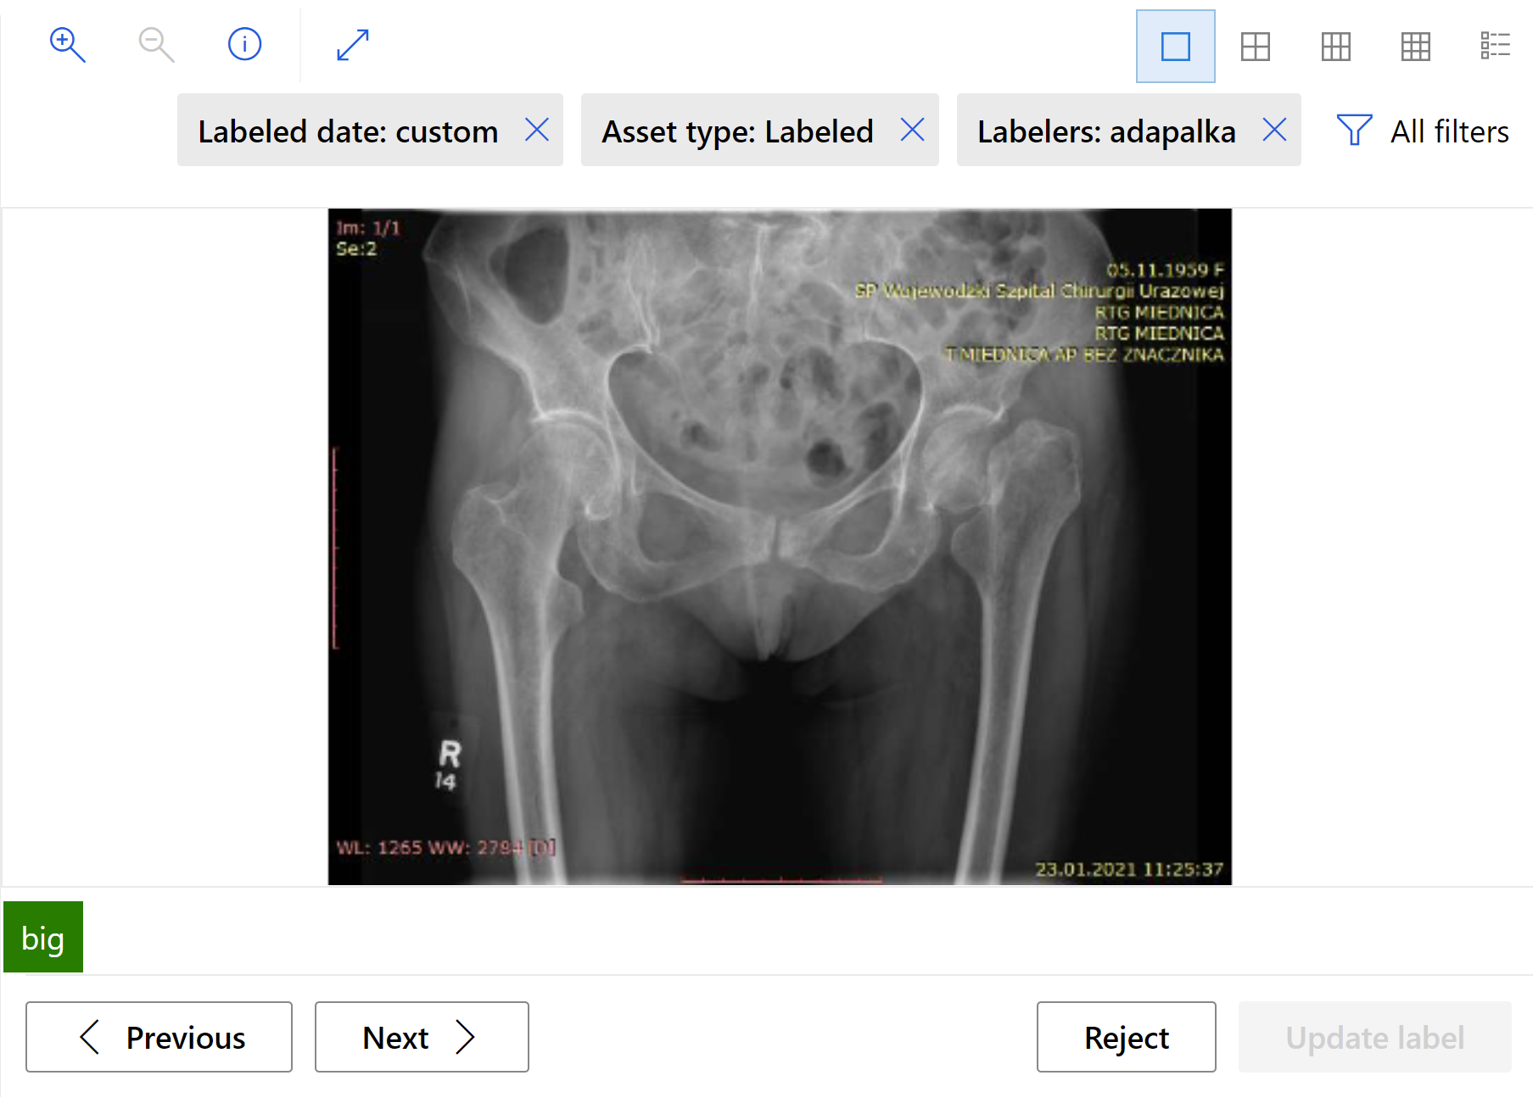
Image Classification: Dataset
Url | Label
AmlDatastore://workspaceblobstore/hips_train/04-23-2022_083926_UTC/hips_train/Panewka Exceed rozmiar 50, trzpień Taperloc Microplast rozmiar 9.jpg | big
AmlDatastore://workspaceblobstore/hips_train/04-23-2022_083926_UTC/hips_train/Panewka Exceed rozm 48. Trzpień Taperloc Microplasty rozm 7,5.jpg | big
AmlDatastore://workspaceblobstore/hips_train/04-23-2022_083926_UTC/hips_train/Panewka cementowa Polarcup Shell rozm 45. Trzpień cementowy Polarstem O.jpg | small
AmlDatastore://workspaceblobstore/hips_train/04-23-2022_083926_UTC/hips_train/Panewka Avantage rozm 44. Trzpień cementowy Taperloc rozm 10.jpg | small
AmlDatastore://workspaceblobstore/hips_train/04-23-2022_083926_UTC/hips_train/Panewka Avantage rozm 46. Trzpień cementowy Taperloc rozm 10.jpg | small
AmlDatastore://workspaceblobstore/hips_train/04-23-2022_083926_UTC/hips_train/Panewka Avantage rozm 44. Trzpień Taperloc rozm 10.jpg | small
AmlDatastore://workspaceblobstore/hips_train/04-23-2022_083926_UTC/hips_train/Panewka Avatage rozmiar 48, trzpień Taperloc rozmiar 10.jpg | big
AmlDatastore://workspaceblobstore/hips_train/04-23-2022_083926_UTC/hips_train/_Panewka Exceed ABT rozmiar 50, trzpień Taperloc Microplasty 12,5.jpg | big
AmlDatastore://workspaceblobstore/hips_train/04-23-2022_083926_UTC/hips_train/Panewka cementowa Avantage rozm 44. Trzpień cementowy Taperloc rozm 7,5.jpg | small
AmlDatastore://workspaceblobstore/hips_train/04-23-2022_083926_UTC/hips_train/M Panewka Avantage 52mm, wkłąd Avantage 5228mm, trzpień Taperloc 15.jpg | big
AmlDatastore://workspaceblobstore/hips_train/04-23-2022_083926_UTC/hips_train/panewka Avantage 44 mm, trzpień Taperloc Hip 10 x 140 mm.jpg | small
AmlDatastore://workspaceblobstore/hips_train/04-23-2022_083926_UTC/hips_train/Panewka Avantage rozmiar 50, trzpień Taperloc cementowy rozmiar 10.jpg | big

Slide 13
Image Classification: Modeling
Data augmentation techniques
Random resize and crop
Horizontal flip
Color jitter (brightness, contrast, saturation, and hue)
Normalization using channel-wise ImageNet’s mean and standard deviation
Model algorithms
MobileNet https://arxiv.org/abs/1704.04861
ResNet https://arxiv.org/abs/1512.03385
ResNeSt https://arxiv.org/abs/2004.08955
SE-ResNeXt50 https://arxiv.org/abs/1709.01507
ViT https://arxiv.org/abs/1706.03762

Slide 14
Image Classification: Modeling
Selected hiperparameters
learning_rate
training_batch_size
optimizer
weighted_loss
train_crop_size
valid_resize_size
valid_crop_size
Sampling methods
Currently only random sampling supports conditional hyperparameter spaces
Early termination policies
Bandit policy
Median stopping policy
Truncation selection policy

Slide 15
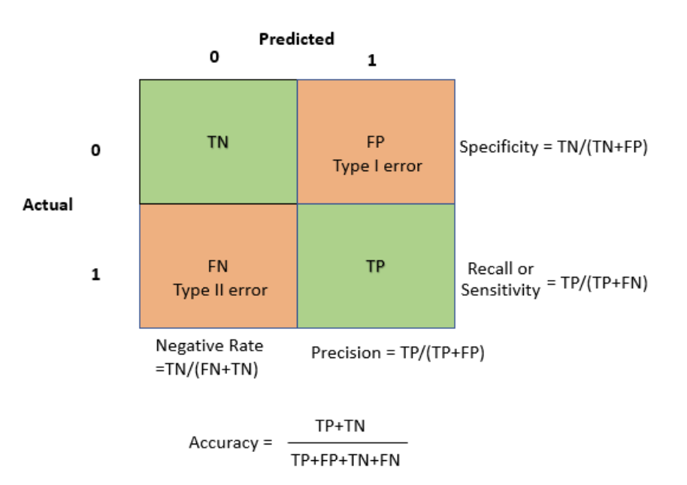
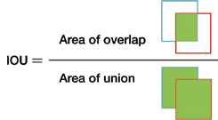
Image Classification: Model evaluation
IMAGE_CLASSIFICATION
Accuracy
IMAGE_CLASSIFICATION_MULTILABEL
intersection over union (iou)

Slide 16
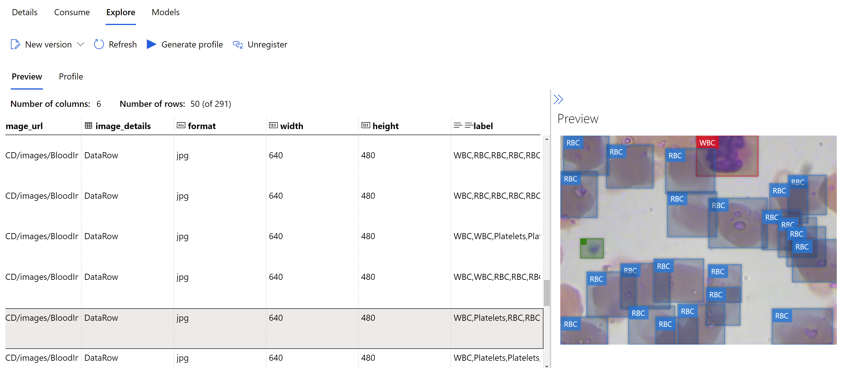
Object Detection: Dataset

Slide 17
Object Detection: Modeling
Data augmentation techniques
Random crop around bounding boxes
Expand
Horizontal flip
Normalization
Resize
Model algorithms
YOLOv5 https://arxiv.org/abs/1506.02640
Faster RCNN ResNet FPN https://arxiv.org/abs/1506.01497
RetinaNet ResNet FPN https://arxiv.org/abs/1708.02002

Slide 18
Object Detection: Modeling
Selected hiperparameters
number_of_epochs
learning_rate
training_batch_size
optimizer
momentum
Nesterov
layers_to_freeze
Sampling methods
Currently only random sampling supports conditional hyperparameter spaces
Early termination policies
Bandit policy
Median stopping policy
Truncation selection policy

Slide 19
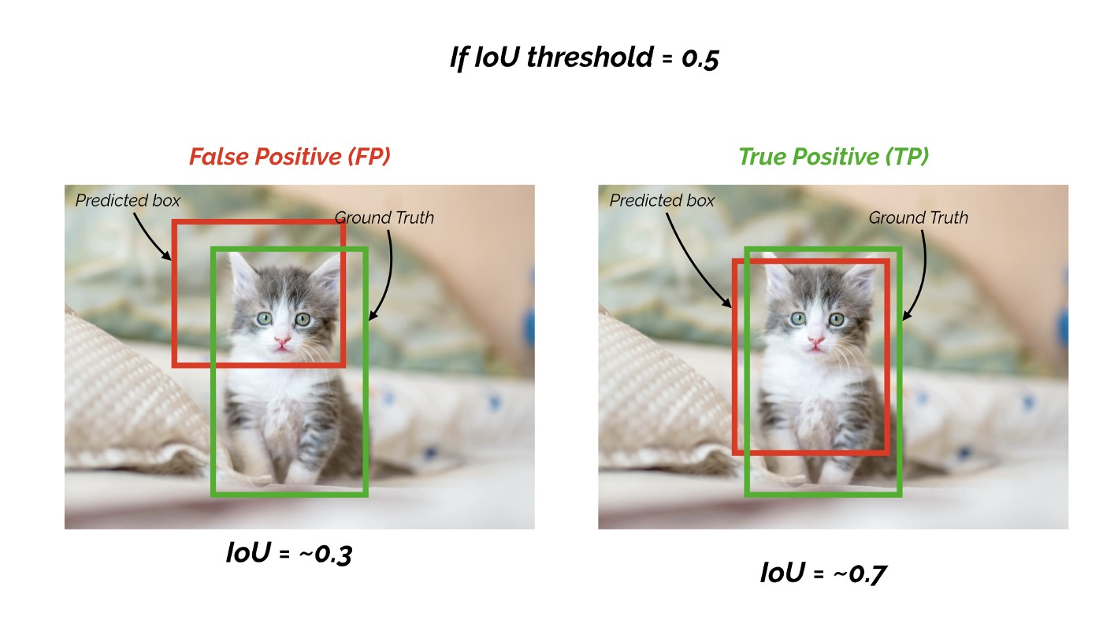
Object Detection: Model evaluation
mean Average Precision (mAP)
The general definition for the Average Precision (AP) is finding the area under the precision-recall curve
mAP is the average of AP
mAP score is calculated by taking the mean AP over all classes and/or overall IoU thresholds, depending on different detection challenges that exist

Slide 20
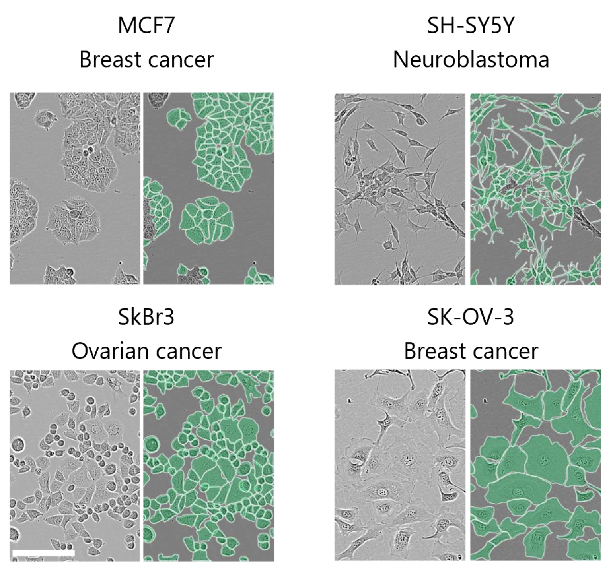
Instance segmentation: Dataset
{"image_url": "AmlDatastore://workspaceblobstore/livecell/livecell_train_val_images/BV2_Phase_B4_2_00d12h00m_1.tif",
"image_details": {"format": "tif", "width": 704, "height": 520},
"label": [{"label": "BV2", "isCrowd": 0, "polygon": [[0.9999147727272728, 0.8382499999999999, 1.0, 0.8112115384615385, 0.9944318181818183, 0.8100769230769231, 0.9890198863636364, 0.81175, 0.98578125, 0.8155576923076923, 0.9833522727272727, 0.8224615384615385, 0.9842471590909091, 0.8287884615384616, 0.9856676136363636, 0.83425, 0.98953125, 0.8389615384615384, 0.9949289772727272, 0.8429230769230769]]}, …

Slide 21
Instance segmentation: Modeling
Data augmentation techniques
Random crop around bounding boxes
Expand
Horizontal flip
Normalization
Resize
Model algorithms
MaskRCNN ResNet FPN https://arxiv.org/abs/1703.06870

Slide 22
Instance segmentation: Modeling
Selected hiperparameters
number_of_epochs
learning_rate
validation_iou_threshold
box_detections_per_img
min_size
Sampling methods
Currently only random sampling supports conditional hyperparameter spaces
Early termination policies
Bandit policy
Median stopping policy
Truncation selection policy

Slide 23
Instance segmentation: Model evaluation
mean Average Precision (mAP)
The general definition for the Average Precision (AP) is finding the area under the precision-recall curve
mAP is the average of AP
mAP score is calculated by taking the mean AP over all classes and/or overall IoU thresholds, depending on different detection challenges that exist

Slide 24
Summary
+ application for many problems
+ ease of use
+ automatically generated metrics and charts
- requires specifically prepared data
- no data augmentation

